Slide 1

Smartphones Price Prediction using Supervised Machine Learning Algorithm Random Forest Regression
Team Members:
Ch. Hemanth Satya Sai
M.Likitha

Slide 2
Table of Contents
Abstract
Introduction
Data Analytics and Visualization
Model Training and Validation
Future Enhancements
Challenges and Learning
Conclusion

Slide 3
Abstract
This research explores the application of supervised machine learning algorithms, specifically regression techniques, to predict smartphone prices accurately. By analyzing a dataset of smartphone specifications and their corresponding market prices, we aim to identify significant features that influence pricing. Regression models, such as linear regression, Decision tree , Random Forest it will be employed to establish relationships between these features and the target variable (price). The performance of different models will be evaluated using metrics like mean squared error (MSE) and R-squared to determine the most effective approach for smartphone price prediction. This research contributes to the understanding of pricing dynamics in the smartphone market and provides valuable insights for consumers and manufacturers alike.

Slide 4
Introduction
decisions, while manufacturers can optimize pricing strategies to maximize profits. This research aims to address this challenge by leveraging supervised machine learning techniques.
By analyzing a dataset of smartphone specifications and their corresponding market prices, we seek to identify the key factors that drive pricing variations. Regression models, including linear regression, Decision Tree, and Random Forest, will be employed to establish relationships between these features and the target variable (price). The performance of these models will be evaluated using metrics like MSE and R-squared to determine the most effective approach for smartphone price prediction.
This research contributes to a deeper understanding of pricing dynamics in the smartphone market. The findings can provide valuable insights for consumers in making informed purchasing decisions and for manufacturers in optimizing their pricing strategies.

Slide 5
Data Analytics and Visualization
Data Features
Handling Null Values
EDA
Model Implementation & Evaluation

Slide 6
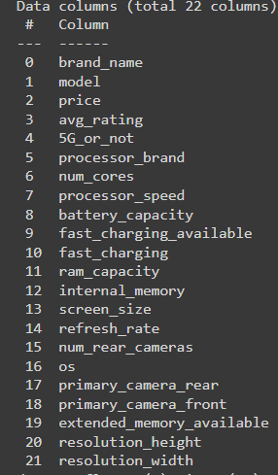
Features
These are the features we used in the price prediction

Slide 7
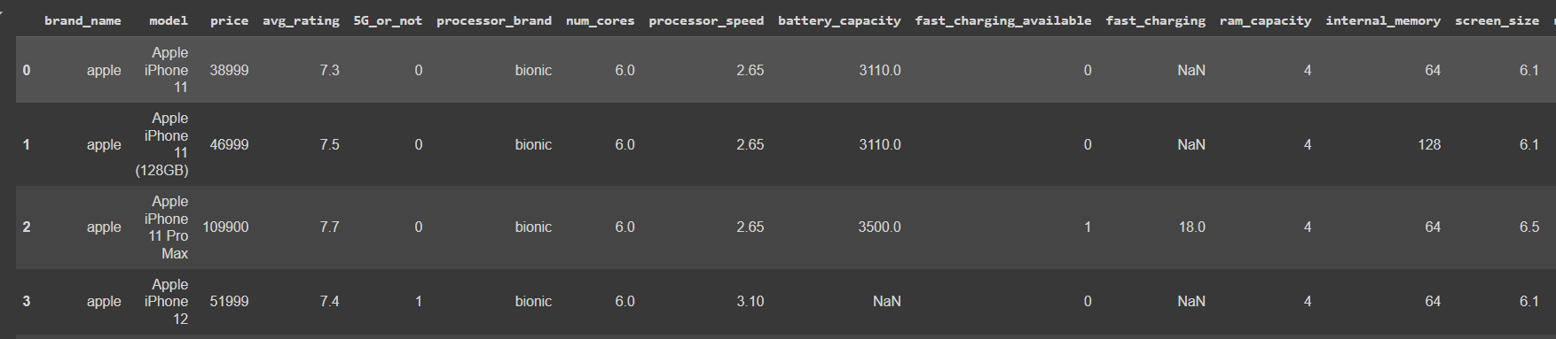
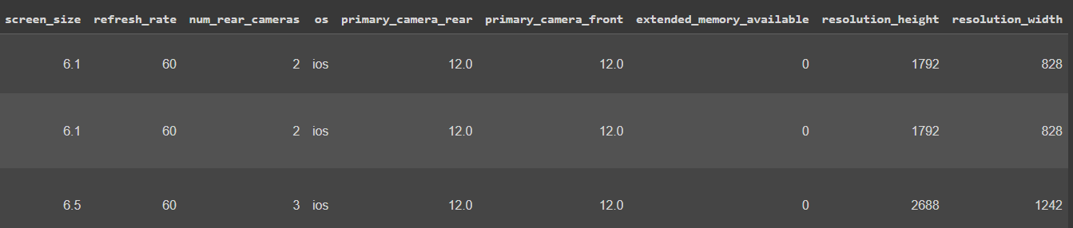
Data
These are the features and data we used in the price prediction

Slide 8
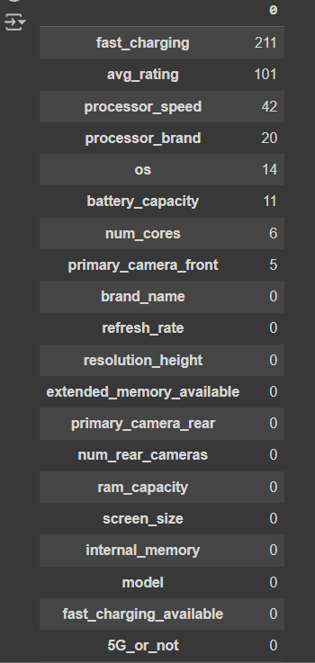
Handling NULL Values
1.We have used mean to fill null values in the following columns:
1. avg rating
2. processor speed
3. fast charging
2.We have used mode to fill null values in the following columns:
1. processor brand
3.We have used zero to fill null values in the following columns:
1. num cores
2. Primary camera front
4.We have used interpolate to fill null values in the following columns:
1. battery capacity

Slide 9
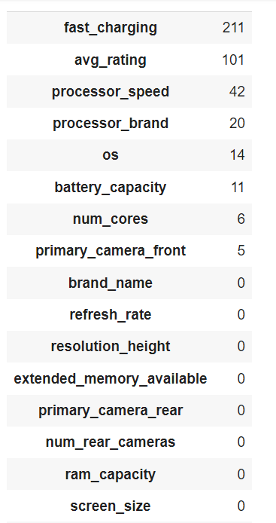
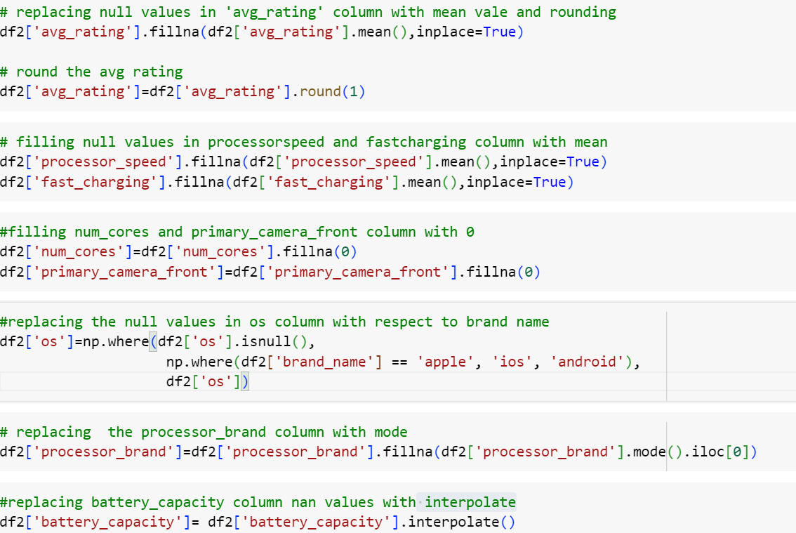
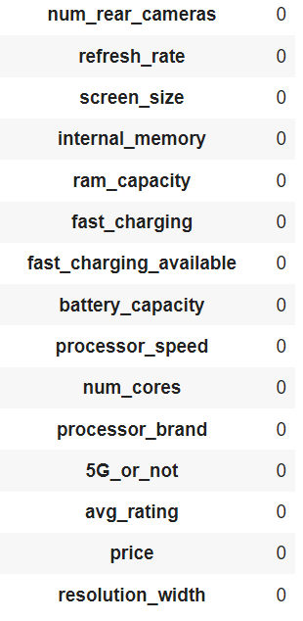
Filling Missing Values

Slide 10
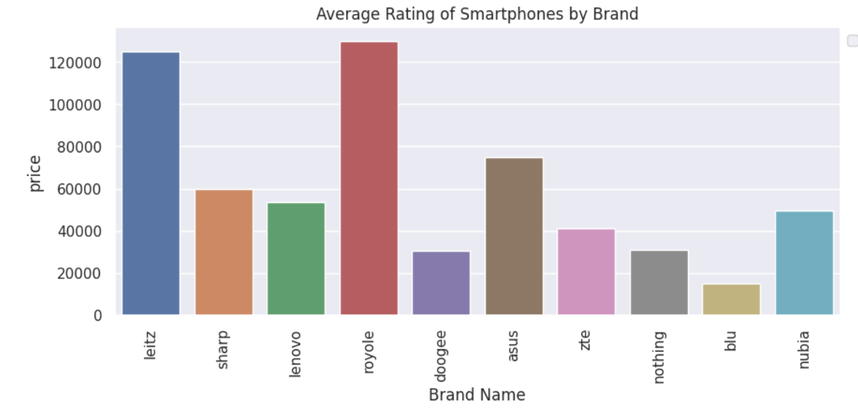
EDA
.
Here we can see that Leitz is highly rated followed by Sharp

Slide 11
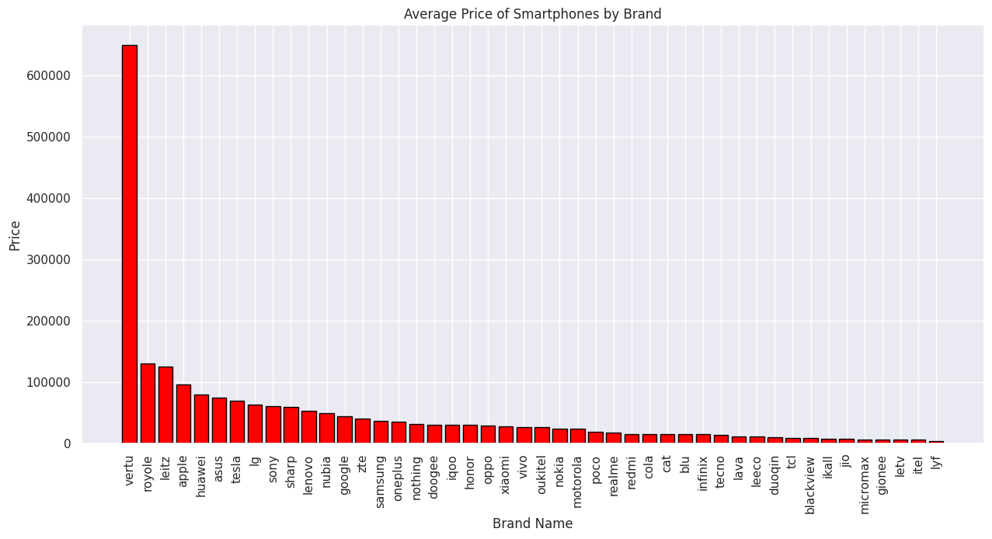
.
Here we can see that Vertu is the costly mobile followed by royale

Slide 12
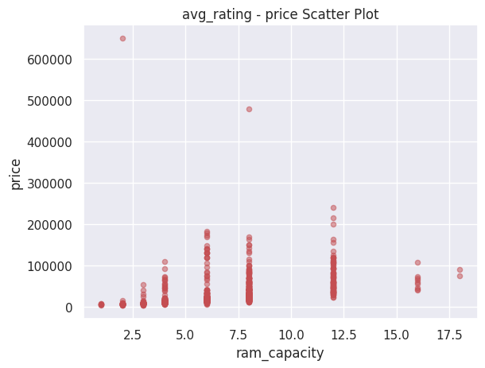
.
Here we can see that as the RAM capacity is increasing price of the smartphone increases

Slide 13
Model Training and Evaluation
Linear Regression
Decision Tree Classifier
Random Forest Classifier

Slide 14
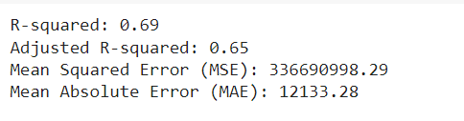

Linear Regression
Linear regression is a statistical model used to predict the probability of an event occurring. In the context of smartphone price prediction, it can be used to estimate the likelihood that a smartphone with certain features (e.g., screen size, RAM, camera megapixels) will fall into a particular price category (e.g., low, medium, high).
Accuracy Score
65.0%

Slide 15
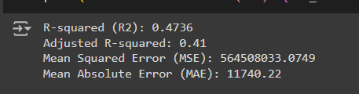

Decision Tree Classifier
A decision tree classifier is a tool that asks a series of questions based on the information provided (like 5g or not , Battery capacity...) to decide on an outcome (price). It splits the data into branches at each question, leading to a clear decision at the end.
Accuracy Score
41.00%

Slide 16
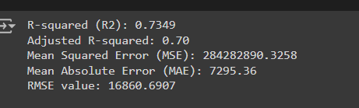

Random Forest Classifier
A random forest classifier is a collection of many decision trees that work together to improve the accuracy of predictions (like whether a price). It looks at different subsets of data and combines their results to make a final decision, making it more reliable than using just one decision tree.
Accuracy Score
70.00%

Slide 17
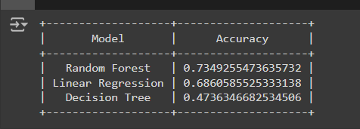
Scores of our Models
Random Forest Regression is more accurate

Slide 18
Future Enhancements
In Future, By integrating a recommendation engine, my smartphone price prediction project can evolve into a more personalized tool. When users input their desired specifications, the machine can suggest suitable models based on their preferences and budget, providing a more tailored and convenient shopping experience.
This enhanced functionality will elevate the user experience and make informed smartphone purchases more accessible than ever.

Slide 19
Challenges and Learning
Data cleaning and preprocessing are critical steps in developing a smartphone price prediction project. Challenges often arise when dealing with missing values in columns like brand details and RAM specifications, as these data points are crucial for accurate predictions. Additionally, ensuring data consistency and scaling techniques can be complex, especially when dealing with diverse and potentially unrelated information. Addressing these challenges effectively is essential for building a robust and reliable model.

Slide 20
Conclusion
In conclusion, the smartphone price prediction model effectively identified key factors influencing device pricing, such as brand, RAM, and processor brand. Random Forest and Linear Regression emerged as the most effective models, demonstrating their ability to accurately predict prices based on these variables. By implementing additional feature engineering techniques, refining model selection and tuning, and addressing data quality issues, the model's performance can be further enhanced, providing valuable insights and supporting informed decision-making in the smartphone market.

Slide 21
Thank you

